Slide 1
RED (Real Estate Database)
Group 8
Robert Drescher, Arianna Mills, Lisa Zhang

Slide 2
Problem Statement
A database system for real estate agents to be able to create, edit, and delete house listings, while clients are able to view and search any existing properties.

Slide 3
Functional Requirements
Agents should be able to add and edit house listings in the database
DB Table: LISTING
Users should be able to search through properties on the database
DB Table: LISTING
Database will store and display agent information
DB Table: AGENT
Database will store and display client information
DB Table: CLIENT
Database will store and display company information
DB Table: COMPANY
House listings should display pictures and basic information such as the status
DB Table: LISTING

Slide 4
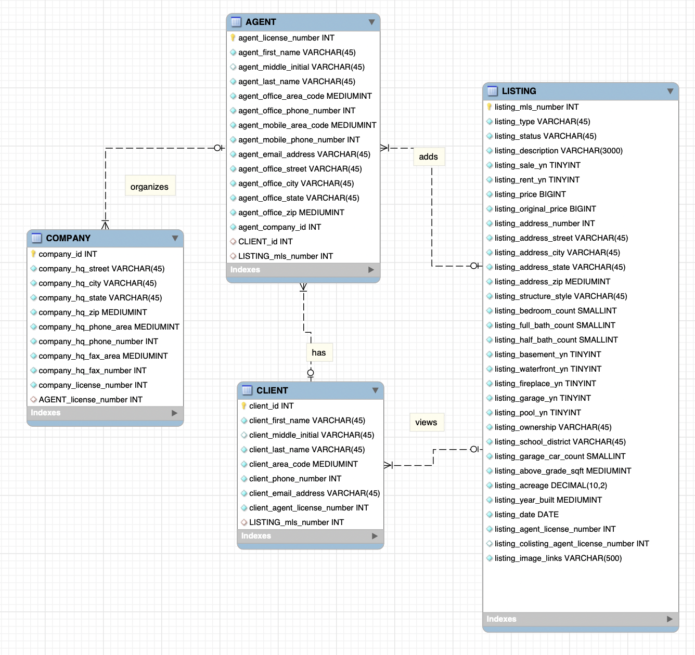
ER Diagrams
4 entities
AGENT
LISTING
COMPANY
CLIENT
List of attributes
Relationships

Slide 5
Tools, Frameworks and Technologies
Tools
GitHub
Visual Studio Code
MySQL Workbench
Frameworks and Technologies
MariaDB
Python 3
Flask
HTML
CSS
JavaScript

Slide 6
DEMO: https://youtu.be/4cVcj1VLGfY

